Slide 1

The structure of FTC

Slide 2
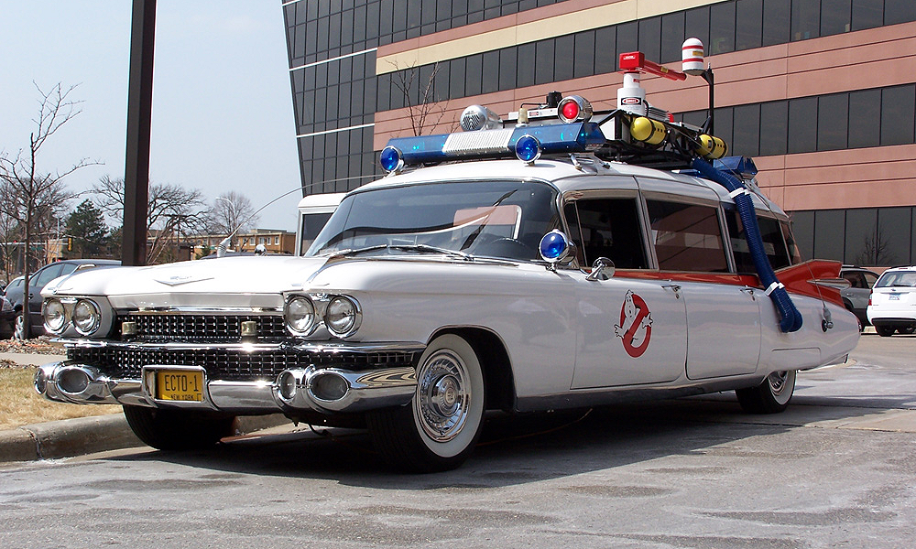
The code in FTC
The code in FTC has to form to whatever FIRST gives us in the sense that we use their API. We put a “cover” over it to make it more streamlined to make mechanism and robots.
Most of what we implement, if the name fits, we add ecto. For example: EctoRobot, the head robot class in FRC.
In FTC the projects work with what they are called OPerational modes, OP modes. They are the robot and they are what control what mechanisms to use and other things.

Slide 3
The structure
Mechanism Manager
the OP mode
mechanism
mechanism
Gamepads, Keybinds, telemetry
Command Scheduler
Commands
Triggers

Slide 4
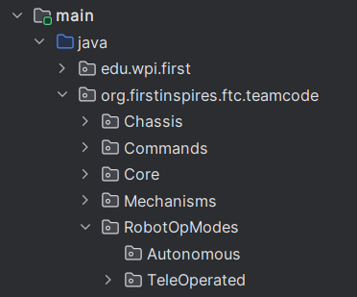
The OP mode
They are the robot and they are what control everything, such as mechanisms and inputs.

Slide 5
Mechanism
This where we tell each individual servo/motor how to specifically move.
An example: Would be an elevator where we need to tell both motors to move at the same time.

Slide 6
Commands
To be able to send an order to a mechanism, we need to first create a command for it.
But why can't we just talk directly to the mechanism??

Slide 7
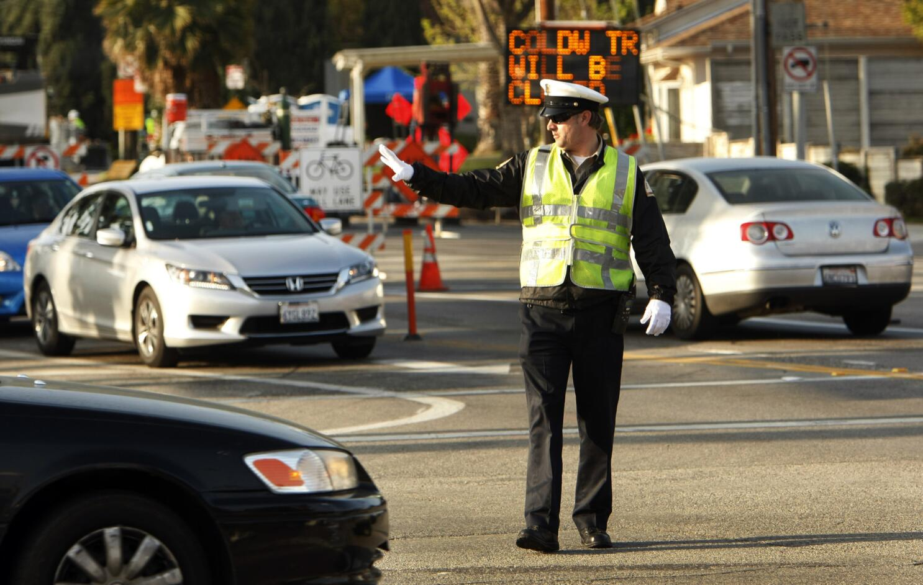
The Command Scheduler
The command scheduler is a class responsible for scheduling all commands.
It allows to run commands in a sequential form or in parallel, as well as controlling what happens if the command gets abruptly interrupted.

Slide 8
In simple terms
Trigger
Command
Mechanism
Motors/Servos

